Slide 1
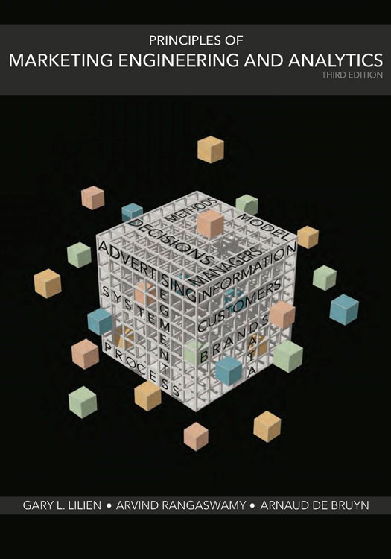
Digital Marketing and Search Advertising
Digital marketing
Search Analysis
Panel data analysis
Notes:
Today, I will introduce you to the fast growing area of Digital Marketing, with a particular focus on the nature of analytics related to search advertising. There is a lot written about digital marketing, and much of it is available for free online. This is a topic on which we can spend one or more semesters. My focus in this course is on one aspect of online marketing, namely, that in the online world, customers leave a trace of what they have done, and this type of data is useful for marketers to engage better with those customers, and to optimize and customize how they do marketing online.

Slide 2
Online Technologies and the
Transformation of Marketing
Notes:
I will start by providing an overview of the evolution of online technologies in business and in marketing, and then articulate what these technologies imply for online advertising. This overview will provide the necessary background for you to do an analytic exercise to evaluate and improve paid search advertising campaigns.

Slide 3
Key Internet/Digital Marketing Strategies
Search engine optimization (SEO)
- no cost per click
Search engine marketing (SEM)
- cost per click
Social Media Marketing (SMM)
  Words of mouth marketing (free)
  Ads on social network Web sites

Slide 4
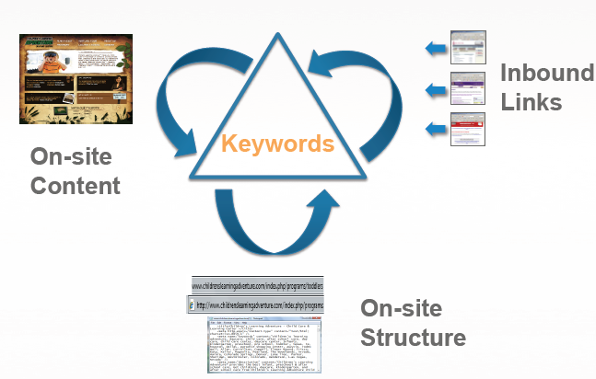
Search Engine Optimization (SEO)
Keywords
(Back links)
(Content is the king)
(Meta tags, etc.)

Slide 5
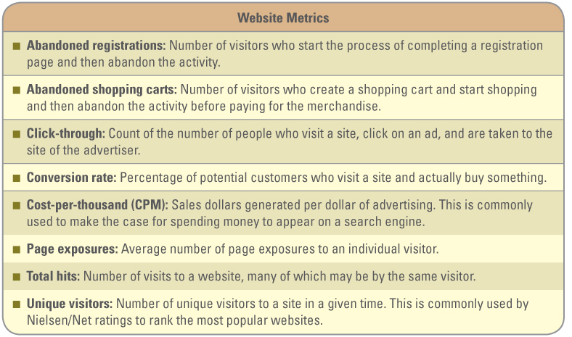
Hit/page hit/ Referrers/ Host (location), domain, IP address/

Slide 6
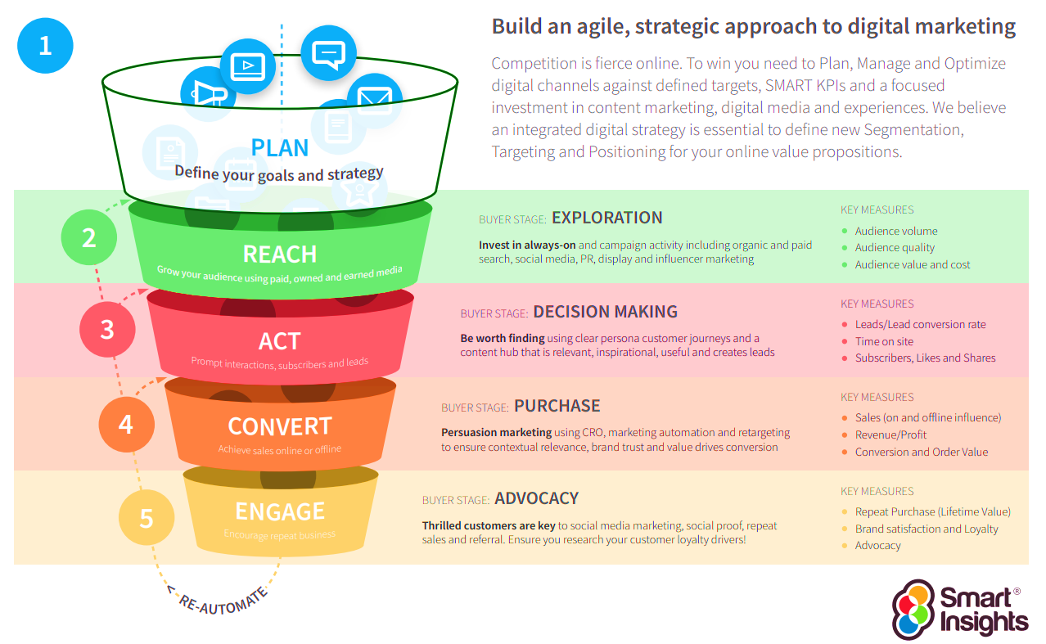
RACE Framework
https://www.smartinsights.com/wp-content/themes/smartinsights/images/smart/digital-marketing-plan-template-smart-insights.pdf

Slide 7
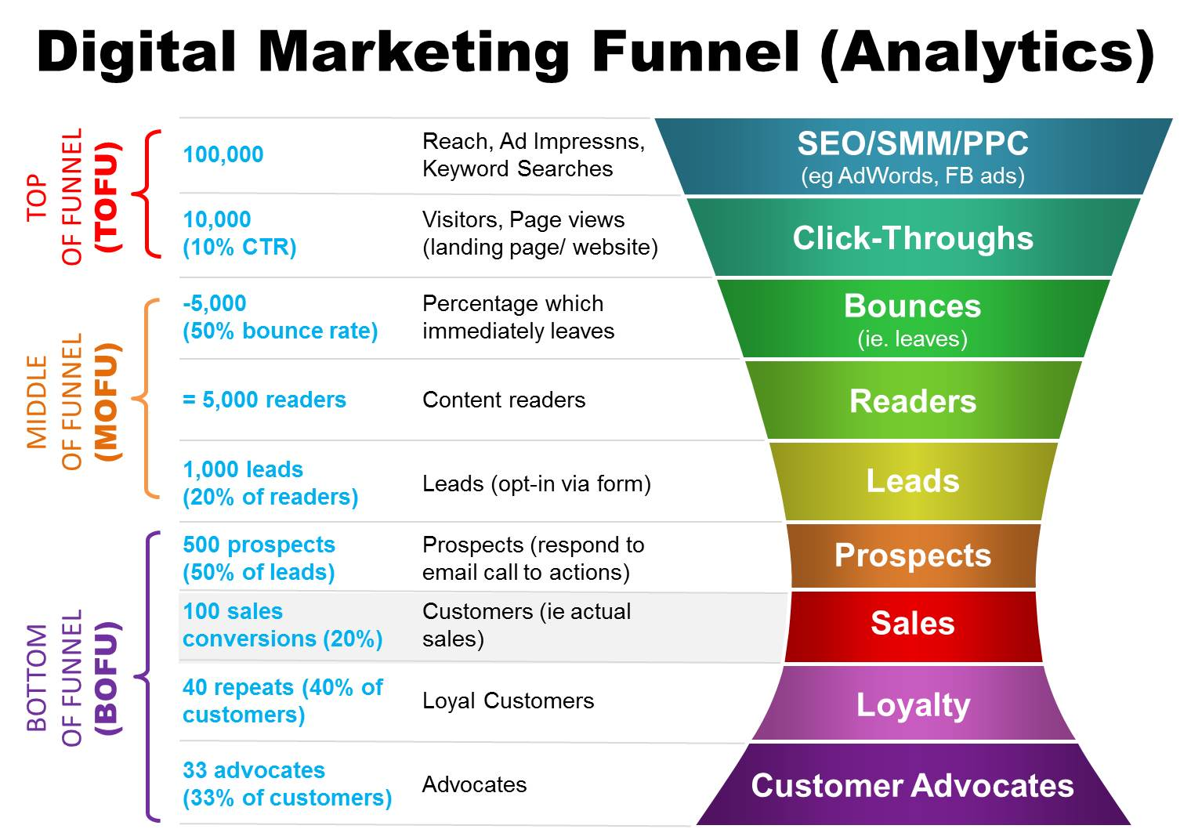
CTR: Click Through Rate
How to Optimize Your Digital Marketing Funnel | Cooler Insights

Slide 8
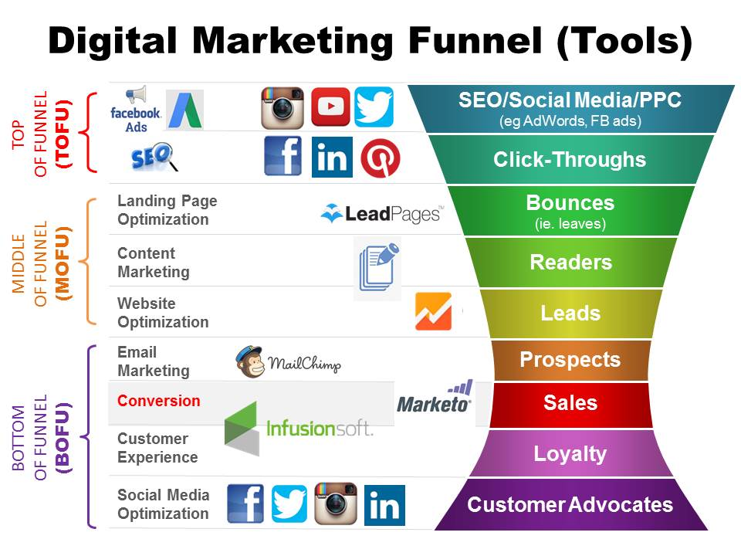
How to Optimize Your Digital Marketing Funnel | Cooler Insights

Slide 9
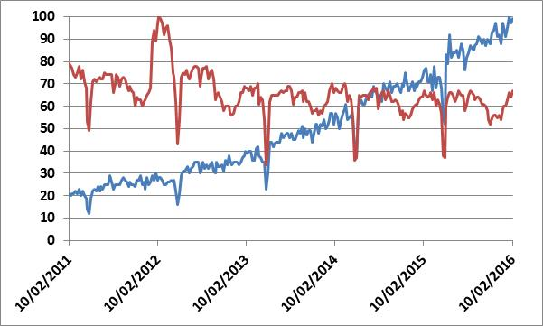
Growing Interest in Digital Marketing
Each series is indexed to 100 for its maximum value during this period, and indicates the interest in the topic based on Google searches conducted on those terms. The absolute number of searches for “Digital marketing” is much smaller than the absolute number of searches for “Marketing.”
From www.google.com/trends (accessed October 7, 2016)
Digital Marketing
Marketing
Notes:
This chart shows that with the greater penetration of online technologies, there has been a growing interest in digital marketing – there is nearly an eight-fold increase in interest on this topic in the past 10 years. Of course, it started from a small base (Google trends from where I picked up this data does not list the absolute number of searches associated with a search term. Interestingly, in the same period, interest in basic advertising or marketing have declined.

Slide 10
Online Advertising
Notes:
In the remaining part of this lecture segment, I want to highlight a few aspects of online advertising as a prelude to my describing paid search advertising, which will be the focus of the analytical exercise. I will start by describing how online advertising differs from traditional advertising.

Slide 11

Broadcast (TV & Radio) – Temporal Multiplexing (multiplexing)
Input
Output
Bandwidth
Content
100%
Temporal
Multiplexing
Advertising
time
E.g., TV Advertising
多路复用（Multiplexing，又稱「多工」）➔
Notes:
This chart summarizes how traditional advertising works in a broadcast medium – advertisers insert their messages between program segments. In the old world of advertising, if you are a large company, you would do an up front purchase of say $10 million or $20 million of media placement, and do a rough match between a TV or radio show and its audience composition. For example, you might have an index to indicate whether a particular show skews towards a younger audience (e.g. when it first came out, American Idol had a younger audience than the other TV shows). If you wanted to target a younger audience then you would pick shows which had a higher index for that audience demographics. That was the type of granularity that was driving the advertising investment decisions. Such targeting might not be bad if the primary goal of advertising is branding. But if you want to drive other goals such as consideration or preference, or sales, then you would need more granularity –not just in terms of audience demographics, but also the context in which you reach a particular audience. In the past, print advertising provided greater granularity in terms of audience (e.g. specialized magazines such as Popular Mechanics or Wired allowed you to reach more specific audiences) and also the context – e.g. inserting an ad for an exercise machine in the sporting pages of a newspaper.
Online advertising allows even greater levels of targeting and contextualizing.

Slide 12
Online -- Spatial Multiplexing
Input
Output
Bandwidth
Content
100%
Spatial
Multiplexing
Advertising
time
E.g., Google AdSense
Notes:
In online advertising, you can, for example, display a particular ad based on the information you may have about a particular web visitor. For example, someone searching for hotels in New York could be shown an ad for Hilton in Times Square. Or, someone from New York looking up weather information in Florida could be shown an ad for discount airline tickets from New York to Florida. We are only limited by our ingenuity in terms of how we target and contextualize the ad for a specific individual. The placement of the ad is typically done next to other content, which also provides a more refined context, adjacent to the content. That is why I call it “spatial multiplexing.”

Slide 13
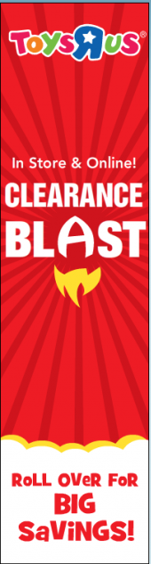






Display Advertising
Banner: 468x60
Skyscrapers
Notes:
When you show an ad online (for example, on a laptop or mobile device), there are some standard sizes that are allowed. This chart shows the type of banner ads that you could show online. When someone clicks on a banner, they could be taken to a web site where we provide additional information or resources to the visitor. Google’s program for display advertising is called Adsense.

Slide 14
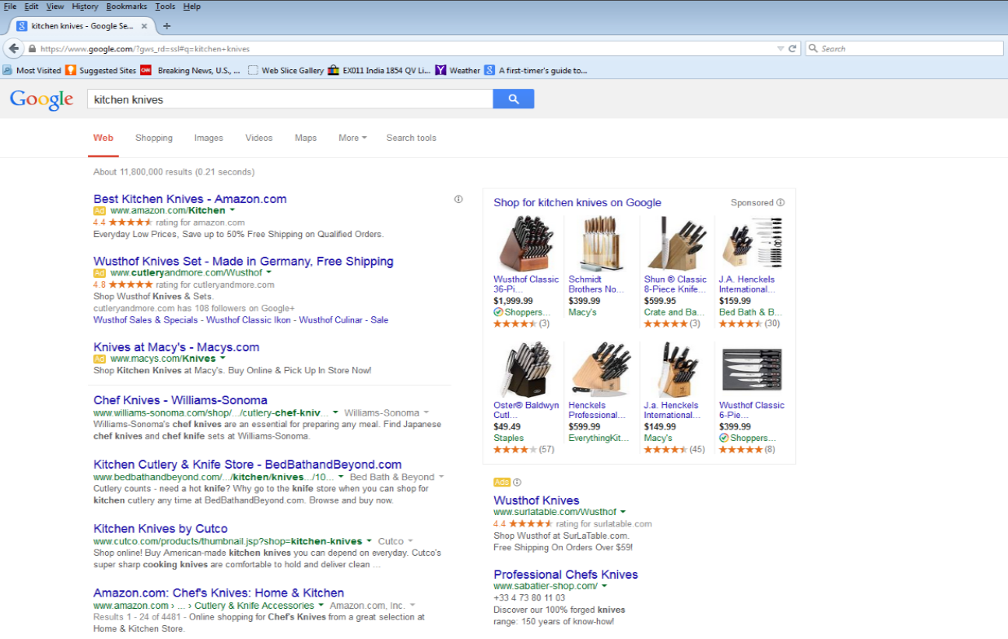
Search Advertising
Google search use PageRank to determine the ranking of pages on the Organic Listing.
PageRank can be improved via SEO (Search Engine Optimization).
You don't need to pay Google when your page is displayed/clicked on the Organic Listing.
Product
Listing
Ads
Text
Ads
Organic
Listings
Text
Ads
Notes:
Another type of advertising occurs when people visit search engines. For example, if you do a search on Google, you will see a page as shown here – this search is for kitchen knives. Part of the results page is filled with text ads. Each text ad seen by a customer is called an impression. There are also listings from specific sellers that show product pictures – these are called product listing ads. Finally, one of the most important set of things you see on the page are organic listings which are ordered according to how relevant is each listing to the search query. These listings are generated by Google’s secret algorithm that determines the relevancy of web pages from anywhere on the web that might have content that is relevant for a particular search query – here kitchen knives.
When you click on an organic listing, that website or webpage may be part of Google’s display advertising network – in that case, if you visit that web page, Google may be display a banner ad. On the other hand, if a customer clicks on any of the text ads, then Google will charge that advertiser a rate that is based in part on the highest bid for a keyword that advertiser had bid. This is called paid search advertising, and the payment to Google is typically done on a pay-per-click basis, i.e. Google gets paid only when a customer clicks on the text ad. It does not get paid anything for displaying the ad on the search page (as above).
In the exercise, we will focus on search advertising (Adwords), and not on display advertising (Adsense). For many small firms, paid search is one of the most effective ways they can generate traffic to their web sites, and thereby for them to generate sales. Roughly speaking, 50% of visits to web pages come from organic listings, and 10% come from paid search.

Slide 15
Advertising: Traditional versus Online
Traditional
Typically one-way
Temporal multiplexing
Content and Ad generally separated
Tradeoffs between reach, richness, and frequency
Consumers reactive
Weak link between advertising and response measurement -- Recall, Attitudes, Intentions
Static ads
Online
Can by two-way
Spatial multiplexing
Content and Ad generally co-mingled
Fewer tradeoffs between reach, richness, and frequency
Consumers proactive
** Stronger link between ad and response measurement – Impressions, Click-throughs
Adaptive ads
Notes:
There are some systematic differences between traditional advertising and online advertising, in terms of their implications for advertisers.
One advantage for broadcast advertising, such as TV advertising, is the richness of the medium, and ability to target a wide audience. But there are tradeoffs between how many people you can reach, how often you can reach a person, and how much richness you can incorporate in the message (e.g., 15 sec commercial versus 30 sec TV commercial). Traditional TV advertising is particularly useful for generating awareness and brand building. Even in print advertising where content and ad are co-mingled, the articles rarely have ads that relate to the stories.
On the other hand, online advertising is particularly useful when you can leverage the context in which that ad is shown, or when you need to adapt an ad campaign quickly due to changing market conditions (e.g. ad shown only on President’s Day). If I am reading an article about problems in the Middle East, an advertiser could potentially show ads to books on that subject, or other background books or papers, links to charitable organizations that provide support in the region, and so on. Another important aspect of the online medium is that you could more directly establish a link between the showing of an ad, and how the customer responds to the ad (e.g. whether the customer ignores the ad, clicks on the ad, and subsequently purchased a product from you, etc.). This is the link we will explore in greater depth in the exercise.

Slide 16
Customer Decision Process for a Beauty Product
Internal trigger (e.g., going on a date)
Replenishment (order online?)
Impulse purchase (windows display)
TV Ads, Catalogs, print ads
Display Ads, e-Mail
…..
Post UGC(User Generated Contents)
Post tweets
Post YoutTube videos
Facebook likes
Search for Ideas and Offerings
Evaluate Alternatives
Purchase Decision
Post-purchase Experience
Need Recognition
Enjoy shopping and trying new stuff (at store)
Search engine (paid ads)
Watch YouTube videos
Follow tweets..
Look for UGC (User Generated Content) e.g., reviews, Beauty Talk.
…
Post Purchase
Behaviors
Inform Others
Others
buy
Beauty Care Decision Process
Advocate
Words of Mouth (WOW)
Good or Bad
Incentives
Please salesperson
Discounts
Points
Samples
Order online, pick up at store
….
Experiment and learn (help from sales staff)
Product displays at store
UGC (ratings/reviews)
….
Source: Adapted from
Rayport and Jaworski
Notes:
I want to highlight one other aspect related to the role of search in a customer’s decision process, which are changing because of the online medium. For example, instead of visiting 10 car dealers before purchasing a car, today customers do a lot of research online about cars, and on average, only visit 3 car dealerships before making a purchase. In this sense, the ability to search has changed customer decision journeys in most product categories in both B2C and B2B products. This chart shows the typical stages in customer decision journeys in the case of beauty products, such as cosmetics sold by companies like Sephora, or Estee Lauder.
The journey starts with need recognition (which is triggered because of a gap between a desired state and current state, as we saw in an early lecture in this course), followed by search for offerings that might reduce that gap, to evaluating alternatives, and then purchasing the product, and then using the product (i.e. post purchase). Eventually, you may recognize a need for something else in that product category, which may trigger a new journey. In the online medium, post-purchase behaviors may also include posting reviews online, or sharing product usage experiences with members of social network, and so on.
To be an effective marketer in today’s world, you need to understand the drivers of the decision journeys of your customers. In particular, I will focus on the role of search, specifically search engines, to gain an understanding of the decision journeys of customers (at least at an aggregate level) and use that understanding to become more effective. What terms do they use to search in product category. What attributes or attribute levels are most searched. What types of searches eventually lead to purchases? Today’s marketers have an incredible amount of data with which to address these types of questions.

Slide 17
Growing Roles of Search and Social Media in Marketing in the US
Top 10 Web Brands (Home & Work, USA) (December 2007, Nielsen)
Brand | Unique Desktop Audience (‘000) | Hours:Min/ Person
1. Google | 117,719 | 1:11
2. Yahoo! | 113,203 | 3:06
3. Microsoft | 98,338 | 0:49
4. MSN / WindowsLive /Bing | 96,448 | 1:53
5. AOL Media Network | 90,850 | 0:48
6. YouTube | 68,582 | 2:09
7. Fox Interactive | 57,591 | 0:34
8. Amazon | 59,624 | 2:01
9. eBay | 59,374 | 1:15
10. Apple | 50,686 | 0:16
Top 10 Web Digital Media Properties (USA)* (August 2016, comScore)
Brand (All sites) | Unique Multiplatform Audience (‘000)
1. Google sites | 240,704
2. Yahoo! sites | 213,333
3. Facebook | 206,333
4. Microsoft sites | 188,837
5. Amazon sites | 186,256
6. Comcast/NBC | 164,245
7. AOL | 159,599
8. CBS Interactive | 158,303
9. Apple | 153,163
10. Linkedin | 127,229
*: Includes both Desktop and Mobile
Aug 2016 data from http://www.comscore.com/Insights/Rankings Check the site for the latest ranking
Notes:
In the final chart for this segment, I have summarized the reach of the online medium. Among other insights, this chart conveys that both search and social media are a major presence in the US. In the month of February 2016, more than 246 million unique individuals in the U.S. visited Google sites (mainly Google and YouTube), and 207 million visited Facebook. This is out of a population of about 280 million Ameicans who are over the age of 8. You can see that search has an amazing reach in the population. Additionally, you see that social media (Facebook) had no presence in 2007, but today is the second most visited platform today.
The reason for the extensive use of search is that we no longer need to organize or memorize information. We can just search. Sometimes that search may be initiated not necessarily at a search engine site, but could be initiated by Siri, or another app. So, the use of search engines will continue to grow for the foreseeable future.

Slide 18
Basic Search Analytics
Search engines
Search advertising
Basic Search analytics
Notes:
In this segment, we will take a deep dive into paid search advertising. We will see in particular how the Adwords service from Google enables companies to reach customers at the moment they are searching online. The Adwords service provides a large amount of data to help marketers understand what their customers and potential customers are searching online on topics that are in some ways related to their company’s offerings.
I will cover the basics of how search engines and search advertising work, and highlight some simple analytics that help you understand the effectiveness of your search advertising campaigns, and importantly, how you could drive profitable growth for your company via search advertising.
This is a lengthy video and you may want to pause a few times to digest the information presented before moving forward.
In the next session, we will explore more advanced techniques to understand the effectiveness of paid search advertising.

Slide 19
Growing Importance of
Search Engines and Search Advertising
Notes:
In the next few slides I will discuss the growing importance of search advertising. At the outset, I want to clarify the distinction between search terms and keywords – these two concepts are distinct, but are often used incorrectly as synonyms. A search term is what a customer types into the search box – it is the exact words customers use to state their queries – such queries may contain grammatical errors, spelling errors, and different customers may use different words to mean the same thing, or use the same words to mean different things. In other words, search terms represent the entire range of how customers express their needs in their own words. On the other hand, keywords are the words and phrases on which advertisers bid to compete with other advertisers when a particular query or types of queries may appear in a customer’s search box. I will elaborate more on these differences later in this lecture, but do keep this distinction in mind.
Today’s marketers have a front-seat view of what their customers are doing online. In particular, the search terms customers are using online to find the company’s offerings, or the discussions customers are having on social media regarding the product category or brand are often useful for identifying issues and trends. So, understanding the content, tone, and frequencies of different search terms is an increasingly important skill for digital marketers. Not only do marketers need to develop a good keyword list for advertising their product categories via search advertising, but smart content marketers use keyword research to find out what topics they should write about online and what phrases they could use in their online content. Finally, the discussions that customers are having online in social media also provide keywords for both search advertising and for content marketing.

Slide 20
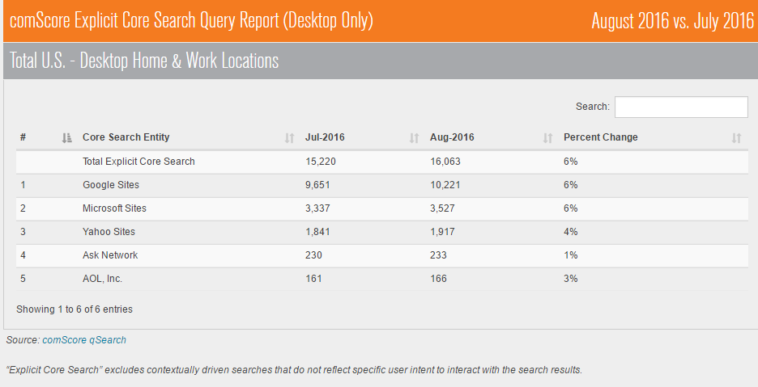
Huge Amount of Search Queries Everyday
From: http://www.comscore.com/Insights/Rankings (accessed October 9, 2016)
About 60% of the searches result in ad displays.
Rankings - Comscore, Inc.
# Core Search Entity Dec-2021 Jan-2022 Point Change
1 Google Sites 61.4% 61.4% 0.0
2 Microsoft Sites 26.8% 26.8% 0.0
3 Verizon Media 11.2% 11.2% 0.0
4 Ask Network 0.6% 0.6% 0.0
Notes:
In February 2016, US customers initiated about 17 billion searches online at search engine sites. And, each time a customer searches online for a product or product feature, it might erode the power of brands. If you build a good brand, then customers automatically reach out for your brand, and do not search online. However, every time customers search online there is a danger that a brand might lose its edge to influence. This dynamic creates the tension that we find in the marketplace today. Good brands make search unnecessary. At the same time, availability of search engines encourage customers to engage in search each time they are trying to buy something, especially of high-involvement products. You can think of the former situation as a brand premium, and the latter as a Google tax.

Slide 21
Online Ad Revenue Growth
Notes:
This chart summarizes the growth in online advertising, which was about $55 billion last year. Must of the online ad spend is on search advertising, which is often very effective.
The total ad spend across media was about 185 billion in 2015 (TV, Radio, Newspapers, magazines, digital, outdoor, directories etc.). Digital is about 30% of total media spend.

Slide 22
Measurability of Online Advertising
“How would you describe your ability to measure ROI from marketing
MarketingCharts.com | Data Source: SEMPO
Notes:
This chart shows that paid search has high ROI compared to other forms of online advertising. SEMPO is an organization that services the search marketing industry. So, you have to view this chart with some caution. My experience is that ROI is also generally high for email marketing.

Slide 23
** Potential Benefits of Search Advertising
Potential for reaching “motivated” customers.
Potential for communicating longer, more content-rich information.
Quicker and less costly to change content seen by customer.
Segment-of-one customization of content (e.g., landing page customization).
Integrates advertising with selling (closed-loop marketing).
Can collect information about who views ads to gauge impact (Advertising and ad research co-mingled).
Notes:
This chart summarizes the key benefits of search advertising. When someone is searching online, it is often an indication of intent or a more proactive stance. On the other hand, such a motivation is missing in media that customers consume passively, such as TV and radio.
Search advertising also offers you an opportunity to show your customer detailed and layered information, unlike in TV or radio where content has to be delivered within a specified time limit.
Content can be changed or customized based on the context – one way to do this is to change the landing page. For example, not everyone visiting Amazon sees the same landing page – the landng page is customized based on the context – from which site did you come to Amazon, which ad did you click, the ability of Amazon to recognize you as an existing customer, etc.
Online you can more readily see the link between advertising and selling. You can often be able to discern whether an ad influenced someone to purchase a product.
And you can get some information about who views your ads, and what effect ads have on different types of customers.

Slide 24
Introduction to AdWords
Notes:
Google offers two programs to marketers -- Adwords and Adsense.
Adwords helps drive traffic to your web site. If you can convert that traffic into commerce, then you monetize that traffic.
On the other hand, Adsense is useful if you are a publisher of content, say you are New York Times. Here if New York Times is a member of Google ad network, then Google might display an appropriate ad to a customer. Google will collect money from athe advertiser fand New York Times will get its cut from that. Therefore, Adsense is a way for publishers to monetize their content.
Our focus in this course will be on Adwords, but the analytic approaches we will learn apply in some broad sense to both types of advertising services.

Slide 25
Some Terminology
Keyword: Words and phrases that an advertiser bids on.
Search term: What a customer types into the search box (or speaks to Siri).
Paid Search: This is what “surrounds” the organic search results at Google.
Display Advertising (e.g., Google's AdSense): An advertisement that is shown to you on a web page to where you are taken when you click on a link from organic listing – here ad network such as AdSense from Google inserts ads on the pages if the publisher is part of the Google Ad network.
Notes:
Please pause the video here to once more review the basic terminology before you proceed.

Slide 26
Overview of How Google AdWords Works
Distributed
Web Crawler
1
Web map
1
Keyword Auction
Process
WWW
1
1
1
2
Cached
Web Pages
Keyword Index
Database
Keyword Ad
Database
5
4
These activities take place in the background. The other activities occur as a result of a user query.
Page-rank
Process
8
4
6
6
Dotted lines indicate browser gets display components from different sources through Google.com.
Google.com
These sources contain
relevant ads
Web Sites/
Landing pages
8
3
7
8
User’s Browser
Customer initiates process
Numbers represent typical sequence of events starting with 1.
Notes:
No single keyword, no matter how well chosen, can only be expected to cover a small proportion of search queries that customers have. So, companies have to manage and bid on a large number of relevant keywords. For example, doctor, physician, surgeon, medical practitioner may all mean the same thing to customers.

Slide 27
Search Advertising
Text
Ads
Paid Product
Listing
Ads
Organic
Listings
Paid Text
Ads
Notes:
As I had indicated before, we will be focusing on understanding the effectiveness of TextAds. These ads only appear with search results if your company had bid an adequate amount on the appropriate keywords, which I will describe in more detail in the next few slides. If you bid a higher amount, you will get a higher position on the paid listings.
You will notice here that amazon.com and macy’s com appear both in the organic listings and the paid search listings. This is not unusual. Even if you can get free organic listings, deep-pocketed companies may use paid search to help direct traffic to a specific web page on their web site, or they may do paid search to prevent competitors from displaying ads (especially smaller competitors may bid on brand names and phrases related to well-known brands so their own company shows up high in organic listings).

Slide 28
Basic Structure of AdWords Advertising
Ad campaign (theme)
Ad group (an Ad associated with any keyword in an Ad group will take customers to the same landing page)
Keywords
  Ad should be relevant to the query and product/service
  Ad copy is important to entice user to click on the ad
Match type (Broad, Exact, and Phrase)
Notes:
Broadly stated, Adwords advertising consists of several components. You can select various ad campaigns (e.g. Summer campaign, Winter campaign, etc.). Within each campaign, you could have many ad groups. Each ad group is associated with a specific web page or content area to which a customer will be directed. This is called a landing page. For example, you could direct one customer to your home page, and another customer to your page containing description of a special offer.
You can have multiple keywords related to a specific ad group – but any customer who clicks on a textad associated with that keyword will be directed to the same landing page.
Finally, each keyword could also be associated with different types of matches with search terms. I will describe these in the next set of slides. Also, you can specify the exact times of day when your campaigns will be active, the specific geocodes during which your ads will be effective, etc.

Slide 29
Basic Structure of AdWords Advertising
Account
www.electrostore.com
Campaign 1
Campaign 2
Televisions
Cameras
Ad Group 1
Ad Group 2
Ad Group 1
Ad Group 2
3D TVs
HD TVs
Compact Cameras
SLR Cameras
Keywords
Keywords
Keywords
Keywords
2-3 Ads
2-3 Ads
2-3 Ads
2-3 Ads
Notes:
Here is an example of how Adwords service is structured.

Slide 30
Paid Search -- Broad Match
Broad match (Keyword: kitchen knives)
  Ad may then show for these search terms:
    kitchen knife
    Knives kitchen
    Cutlery on sale
    Kitchen utensils in New York
    Chef’s knife
Notes:
By associating a broad match with a keyword, you are essentially allowing Google to optimize your advertising. This may turn out to be more expensive than other types of matches, but it has the potential to bring in customer types you had not actively targeted. However, you have to make sure that these are not marginal customers who only come to buy your loss leaders.
Some search terms may contain words that suggest people are simply looking for information: For example a search term “what are the standard sizes for kitchen knives” suggests that the customer is just looking for information. You wouldn't want to turn down a visitor who had entered that search term into their browser, but that user may be less likely to convert than someone who entered the search term “where can I buy kitchen knives"

Slide 31
Paid Search: Phrase Match
Phrase match (Keyword: “kitchen knives”)
  May show whenever the keyword is present somewhere in the search term. Examples:
    Best kitchen knives
    Kitchen knives in New York
  But not for these search terms:
    Knives for kitchen (there is an extra word in between)
    Knives kitchen (the words are reversed)
    Kitchen knife (this is the singular)
    Hunting knives (the words are different)

Slide 32
Paid Search: Exact Match
Exact match (Keyword: kitchen knives)
  May show for the following search terms (allows close variants):
    kitchen knives
    Kittchen knives
    Kitchen Knives
    kit chen knives

Slide 33
Paid Search: Negative Keyword Match
Negative match (Keyword: cheap)
  Your ad will never show for these search terms:
    Cheap kitchen knives
    Where can I buy cheap knives
There are also some more advanced options such as Single word phrase match, and Negative broad match.
Notes:
You may want to add more qualifiers to your broad match in order to improve the quality of the visitors you get from broad match. A single word phrase match on “knives” will allow ads when the search term is “buy knives” or “butcher knives” but not for kitchen utensils. A negative broad match means for “kitchen knives” means that a search term “knives for kitchen” or “knives used in an Amish kitchen” but search terms such as “kitchen cutlery” or “cutting vegetables” could trigger the ad.

Slide 34
Measuring Effectiveness of
Online Advertising

Slide 35
“Funnel” Analytics for Assessing AdWord Effectiveness
1000
1000
Impressions
$$
Spent
10
Clicks
100
1%
Click-Through Rate (CTR)
2
Conversions
10%
10%
1%
2%
Conversion rate
$$$
Got
10%
ROI
Notes:
This is an overview of how the effectiveness of online advertising is typically measured. The holy grail is a conversion – which might stand for anything valuable that a customer does (a conversion could be that the customer called your sales rep, the customer subscribed to your service, or the customer downloaded a whitepaper – the marketer defnes what is meant by a conversion).
In the case of display advertising (say Adsense), you have to pay for impressions, usually you will charged a certain amount for 1000 impressions, called CPM.
Here, if your average cost per click is $2, then you spent $20 for the advertising, and you got 2 conversions. So, the cost per conversion is $10. Suppose the 2 conversions resulted in one sale where you got money for your efforts. Let us say you sold a product worth $100, which gave you a net contribution of $22 from that sale. You paid $20 for the advertising. So your net profit is $2, which 10% of your advertising dollars. This is how you come to 10% ROI. Of course, you do not know whether the sale could have occurred anyway, in which case you lost $20 through the unnecessary advertising, but if this is a new customer you could not have gotten, then it is certainly worth it. 10% ROI is very high especially given that this gain is realized in a short time period.
Return on investment (ROI) is the ratio of money gained or lost on an investment relative to the amount of money invested. If the 10% return here occurs in a few days, that is a tremendous return. Even a 1% return over a week is very good– that is a 52% annual return.

Slide 36
Some Advertising Metrics
Impressions or Exposures
  The number of times a page containing the ad is viewed (measured as the number of times an ad rotates through or pops-up on a web site).
Cost-per-thousand impressions (CPM)
  The cost of gaining 1,000 impressions/exposures. For example, if a banner ad has 30,000 impressions at a web site at a CPM of $5, the total cost of the ad is $150.
Click-through-rate (CTR)
  The number of visitors delivered to a site by a particular advertisement or the percentage of people who click on a web banner and visit a site, computed as a percentage of impressions.
  An ad that generates only 1000 exposures, but gets 40 clicks is more efficient than one that generates 10,000 exposures but only generates 100 clicks.
Notes:
These next couple of slides provide exact definitions for the funnel metrics we just discussed.

Slide 37
Some Advertising Metrics
Cost-per-click (CPC)
  It is the price you pay for each click on your ad.
  Determined via a formula that takes into account your maximum bid and bids of those you are competing against, adjusted for quality of your ad.
Cost-per-visitor (CPV) – mainly for display advertising
  The cost of a given ad divided by the number of clicks obtained from it.
  It combines CPM and CTR to evaluate effectiveness of ad placements
  On a website with a CPM of $20 and a CTR of 2%, it costs you $1 per visitor; a website with a $40 CPM and a CTR of 10% costs you $0.40 per visitor. The higher CPM ad actually has greater value to you.
Cost-per-conversion/Action (CPA)
  Cost of a given ad divided by the number of orders (or other measures of conversion such as filling out a call request) received through that ad. CPS is cost per sale.

Slide 38
Hierarchy of Keywords
Brand keywords – contains brand name in the keyword
  Usually will get good conversions (low CPA)
Product keywords (what product is, or does, or problems it solves)
  Higher cost per conversion than branded keywords
Competitor keywords – contains competitive terms or competitor brands
  Could be helpful if you are not the major player. Higher CPA and also higher CPC (higher CPC because it will get lower Google quality score).
Notes:
I want to now illustrate different type of keywords you can select for your ad campaigns.
1, A branded keyword contains your brand name. This could work for customers who are already familiar with your brand. Typically, branded keywords will have higher clickthrough rates and lower costs per conversion because such customers are further along on their decision journeys.
2. A product-based keyword contains a description of what your product is or does, and what problems it solves. Depending on how diverse your array of products or services this list of keywords could be large. People who are searching for these terms may still be in the earlier stages of their decision journeys, especially when compared to those using branded keywords. And, the cost per action (CPA) will usually be higher than for branded keywords. However, you will be attracting a different kind of customer with product related keywords as compared to brand related keywords.
3. Usually, if you use your competitors brand name or terms in your keyword, Google will reduce the quality score associated with your keyword, and you will get a lower position on the paid listings, and therefore you will have lower effectiveness of your ads. However, if your conversions are still profitable, or if you are small competitor this type of keyword advertising may still pay off.

Slide 39
Hierarchy of Keywords
Substitute product keywords (e.g., airlines and trains)
  Usually will have lower Google quality score, higher CPC, and higher CPA.
  Lower position in organic listings.
Complementary product keywords
  Could get decent CPA in case of strong complementary products (e.g. airlines and rental cars).
Audience/Segment related keywords
  May be effective for getting impressions, but not clicks or conversions.
Notes:
Some products may be close substitutes and others may be weak substitutes. Satellite TV and cable TV may be weak susbstitutes whereas Coke and Pepsi are close substitutes (at least for those who are not too brand conscious). The idea for this type of keyword advertising is to show a text ad for your product when a customer is searching for a substitute product As with competitor terms, Google won’t give you a lot of credit for relevance on these keywords, so they will be more expensive to bid on to get a higher position.
Keywords could also contain complementary product terms, which are products or services that complement or enhance your product or offering. An example is to bid on keywords related to monitors when a customer searches for a computer. Or showing ads for rental cars when there is search query for bus tickets.
Finally keywords may be based on words and phrases meaningful to an audience. For example, the word “amazing” is used disproportionately by some groups, such as millennials. Including such words in your keywords may appeal to some customer groups. Usually you are likely to get a lot of impressions but lower conversions with these types of keywords.
You can see from my discussion, that it is complex exercise to try to get the right set of keywords that align with your strategy. Each keyword may appeal to different groups of potential customers at different stages of their decision journeys, and their costs may vary substantially. So if you spend a lot of money on search advertising, you need to first develop good operational and strategic guidelines for your search campaigns.

Slide 40
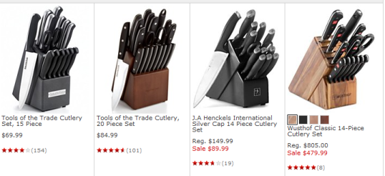
Driving Demand Through Search
Increase conversion rate
Visitors | 1000 | 1000
Conversion Rate | 2% | 3%
Conversions | 20 | 30
 | Base
Notes:
There are two broad goals for search campaigns. You want to attract a large numbers of potential customers – this is what we call traffic. Then, you need to also convert these folks into purchasing something from you. If you get both right, then you have attracted the right kind of traffic to your site, and you are likely to find customers who will become loyal to you, rather than just attracting customers who do one-off transactions with you.

Slide 41
Driving Demand Through Search
Increase conversion rate
Increase potential customers (traffic)
Visitors | 1000 | 1000 | 2000
Conversion Rate | 2% | 3% | 1.5%
Conversions | 20 | 30 | 30
 | Base

Slide 42
Driving Demand Through Search
Increase conversion rate
Increase traffic
Or both
Visitors | 1000 | 1000 | 2000 | 2000
Conversion Rate | 2% | 3% | 1.5% | 1.8%
Conversions | 20 | 30 | 30 | 38
 | Base

Slide 43
Dayparting
Dayparting is a term used for describing placement of different ads at different rates during different times of a day. Increase bids during times when conversion rate is above average and decrease bids during periods when conversion rate is below average. This can be done using “bid multipliers.”
Average Conversion Rate
Notes:
In dayparting you breakdown a given day, week, or a year into different time slots, and find those time slots that are most effective for reaching your target segments, namely, when you are likely to get high conversions, and find the right types of customers. For example, you might want to show ads for happy hour deals for your restaurant a few hours before happy hours start, and close down that campaign past the happy hour times. Or, for example, Hotel deals are probably best advertised on Fridays so people can plan a quick getaway.

Slide 44
Some Strategic Considerations
Before you spend more money on search advertising, make sure you reallocate current spend optimally. You get infinite ROI by reallocating current spend in a way that increases profits.
In search advertising, setting an overall budget is less important than knowing its profitability!
You need customized analytics to assess profitability.
Use benchmarks (your past data, average industry data) to guide spending increases.
Notes:
As we have seen several times during this course, in budgeting, it is important to figure out how to spend wisely before you can determine how much to spend. This logic also applies for paid search campaigns, as you will see in the case you will be analyzing. In the case of paid search, there is an important corollary to this concept because you are often able to calculate the exact amount of profit associated with each keyword. Therefore, you do not need to set a fixed budget. Instead you can keep spending as long as your returns are positive. If you think in terms of spending a fixed amount of money for search advertising, more likely than not you will end up paying the search engine more than you really need to pay to achieve your goals.
The main thing to worry about is to have the means to calculate the profitability of each keyword and campaign. It is also useful to establish benchmarks so you can bring in a continuous learning process into this type of campaign management.

Slide 45
Some Actions to Take to Improve Paid Search Performance
Operational guidelines
Eliminate keywords that are low performing (low CTR, high CPC, or low conversions).
Convert high-performing broad match keywords to exact match keywords.
Modify bidding according to daypart performance.
Limit number of keywords in an Adgroup (it may even be ideal to have one high-volume keyword per Adgroup!)
Strategic guidelines
Find keyword themes that are best aligned with your product and your current and potential customers (e.g. branded keywords, keywords that contain “free”).
Rationalize the set of keywords used – minimize keyword creep.
Notes:
This slides provides some guidelines that will be especially useful for completing your assignment. There are two aspects to developing a good search campaign using the data from your past campaigns. The first is operational – namely, to get rid of keywords that may not be working too well, exploring dayparts or geographies that are most effective for conversion (if that is your goal) or for impressions (if that is your goal). You can also explore other operational aspects, such as whether the number of keywords in some ad groups are too many (recall that each ad group takes a customer to a particular landing page. Also, you could have different match types for the same keyword, and you could potentially put different match types on high-volume keywords into different ad groups.
If the CTR (clickthroughs) for a keyword is low, it means the ad was not relevant for the search queries. If that keyword is a broad match, it means that you could potentially convert it to exact match to see if that would improve CTR. You could also check the average position for that keyword to see if you bidding more to get a higher position might be worth it, especially if conversions per click are high.
CPC: Cost per click. If it is high, then you are bidding too much. Or, your keyword is very desirable to a lot of other deep-pocketed competitors. If this is a broad or phrase match keyword, you could potentially convert to an exact match keyword. Conversion costs also vary quite a bit across industries -- e.g., they are higher for legal and employment services, but lower for dating services. A high Cost per click could also be due to poor landing page that hinders conversion, or your product is not meeting the needs of the customers you were able to attract. The average cost per click for search advertising across all types of industries is about $2.30 whereas the cost per click for display advertising is about 60 cents – the lower cost for display advertising is because it brings in leads that are less qualified than what you get from search.
Cost per conversion: If this is too high, you may want to drop such keywords, or modify the keyword with more specificity – e.g., use negative match to get rid on non-performing traffic. Depending on the product you are selling, cost per conversion of more than $30 is just too high, although if you are selling an expensive item (e.g. Rolex watch), such a conversion cost might be acceptable.

Slide 46
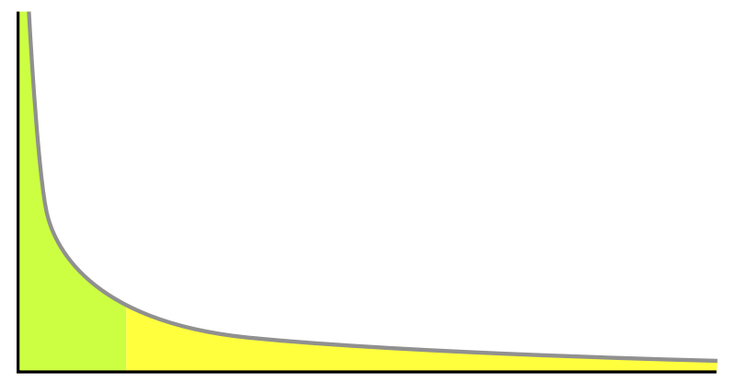
The Long Tail Phenomenon
Head: A few keywords generate a large amount
of traffic and total conversions, but cost more.
Conversions
Tail: These keywords generate low traffic and conversions but bring in different kinds of customers, and cost less
Keywords
Notes:
I will conclude this lecture by describing a concept that is widely applicable online. This is known as the long-tail phenomenon, a more extreme version of the 80-20 rule. Some keywords perform very well both in terms of volume the volume and costs of conversion, whereas there are others that perform poorly. Identifying such good “head” keywords requires a lot of knowledge about your current customers, and future potential customers – what are their needs, and how do they express those needs? Analytics can play a significant role in developing this understanding.
The tail may contain keywords that attract a particular kind of customer who may be important for your future. Suppose you are a gaming company, you may attract some corporate executives who are searching online to incorporate some gaming aspects into their marketing campaigns. So, a careful examining of search terms that are triggering the tail keywords may pay off.

Slide 47
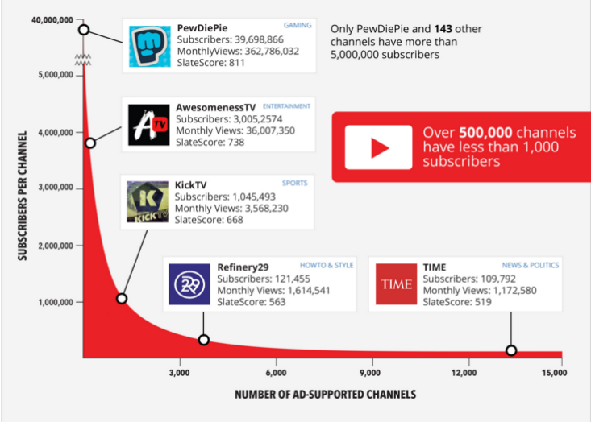
Another Example of the Long Tail
Source: www.openslatedata.com
Notes:
Here is another example of the long-tail phenomenon from the online world. Less than 1% of the Youtube channels get about 99% of the traffic.

Slide 48
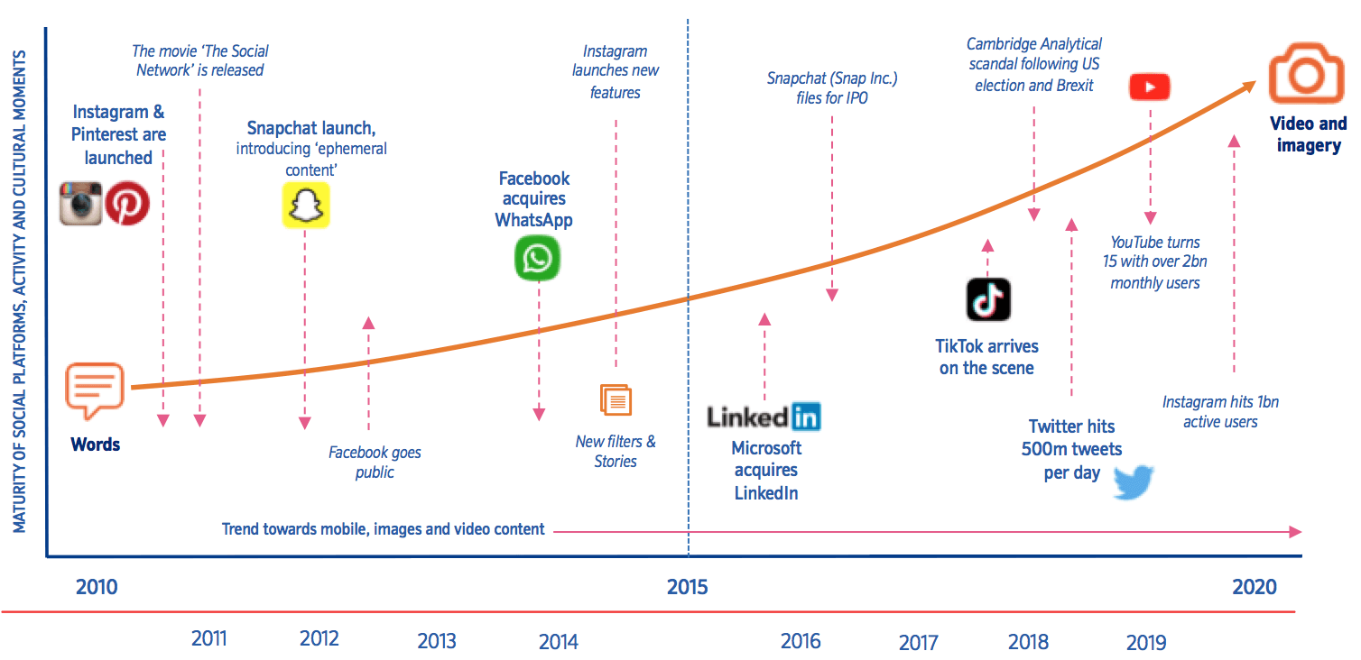
Grow your E-commerce strategy Through Social Media
** Social commerce 2022 trends : Tactics and tools growth | Smart Insights

Slide 49
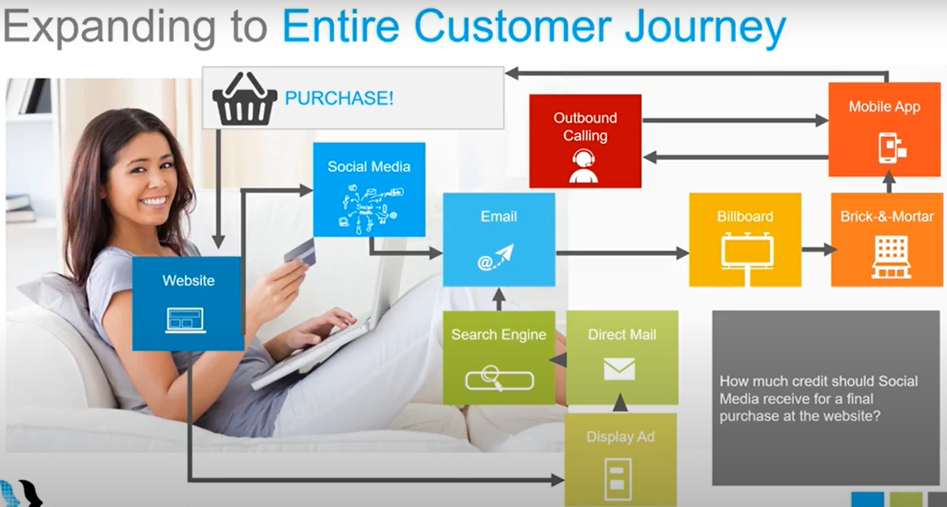
Attribution Modeling and Multi-Channel Marketing
https://www.youtube.com/watch?v=mZconLBGeqM

Slide 50
The End
The End

